Slide 1
LICHESS GAME ANALYSIS
PROJECT

Slide 2
TEAM MEMBERS
YUSUF MAHMOUD YUSUF “ Cleaning using power query & Homepage Overview dashboard”
OLA HAZEM MOHAMED “Player dashboard & DAX & Design “Layout of project dashboards”
RODINA OSAMA IBRAHIM “Opening dashboard & DAX”
SEIF ELDEEN KHALED “Cleaning using python & Moves dashboard”
OMAR ABDELKAREEM “Performance dashboard”
ROWIDA TAMER “Performance dashboard”

Slide 3
OUTLINES
01
OBJECTIVE
02
DATA SOURCE
BUSINESS QUESTIONS
03
04
KPIS & INSIGHTS

Slide 4
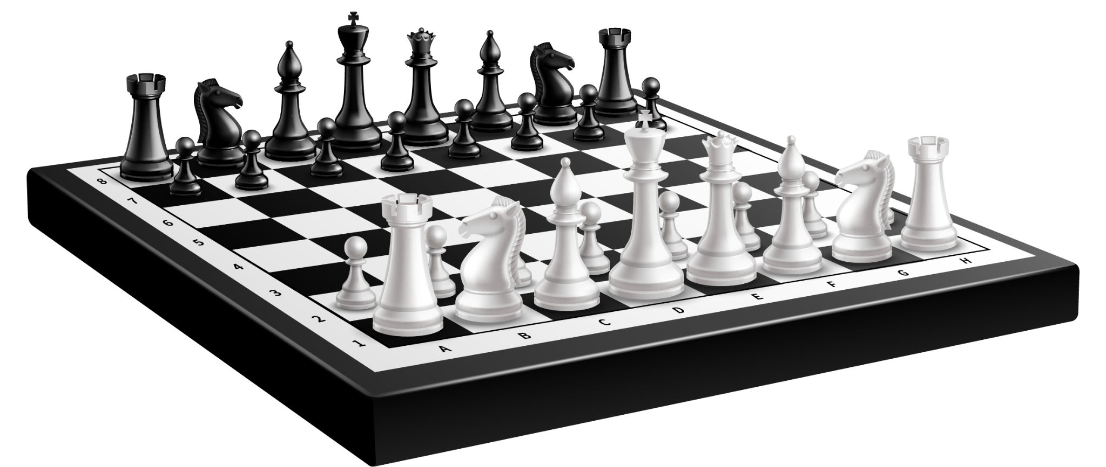

01
PROJECT OBJECTIVE

Slide 5
PROJECT OBJECTIVE
Project Idea – Chess Lichess Analysis Dashboard
This project aims to transform raw Lichess game data into a powerful, interactive Power BI dashboard that helps players, analysts, and chess enthusiasts understand their gameplay at a deeper level. The goal is to deliver a visually engaging and insight-driven analytical experience that uncovers patterns in openings, move behavior, game outcomes, and player performance over time.
Purpose
To provide a production ready analytics solution that identifies performance trends, highlights strategic strengths and weaknesses, and supports data-driven decision-making for training, competition, and product development.

Slide 6
PROJECT OBJECTIVE
Key Features
Automated data cleaning using Power Query and Python
Extraction of piece-movement patterns directly from the moves column
KPI visuals that track openings, accuracy, game length, and move distribution
Intuitive and user-friendly dashboard pages for deep performance analysis
Insights tailored for casual players, competitive players, coaches, and product teams
Future Improvements & Market Potential
AI-Powered Opening Recommendations
Suggests optimal openings based on player history and performance patterns.
Win Probability Prediction Model
Calculates real-time likelihood of winning based on move progression and game context.
Mobile-Optimized Analytics Version
Provides a simplified dashboard for quick insights on phones and tablets.
Multi-Platform Data Support (Chess.com & FIDE PGNs)
Expands the dashboard to analyze games from several chess platforms, not only Lichess.
Premium Insights & Coaching Reports
Offers advanced paid analytics, personalized training insights, and tournament preparation reports.

Slide 7
02
Data source

Slide 8
Data Source (Brief Description)
Source:
  Chess Game Dataset (Lichess)
  The dataset was downloaded from Kaggle, containing thousands of real Lichess games in CSV format
  Online Chess Game Dataset
Description:
  Size: Thousands of matches
  Key Columns: Player IDs, Ratings, Winner, Victory Status, Turns, Time Control, Opening Name
  Purpose: Each column offers a different analysis perspective (performance, duration, strategy).

Slide 9
03
Business questions

Slide 10
Business questions
Does White have a higher chance of winning than Black?
What are the most common victory statuses (Checkmate, Resign, Timeout)?
How does time control (e.g., Blitz vs Rapid) affect game outcomes?
Are shorter games more likely to end in resignation?

Slide 11
Business questions:
What are the most popular openings, and which have the highest win rates?
Does player rating significantly impact winning probability?
Who are the top-performing players in terms of win rate?
Is there a relationship between rating difference and game length?

Slide 12
04
Kpis & insights

Slide 13
1-⏱️ Time-related KPIs
1. Average Game Duration
  Columns Used: created _ at × last _ move _at
  Description: Average duration of games. This helps analyze whether players prefer longer or shorter matches, and whether their performance is better in the morning or at night.
2. Most Popular Time Control
  Columns Used: increment _ code
  Description: Identifies the most frequently played time control (Bullet, Blitz, Rapid). From this column, we can create a derived column to categorize games into these three types and link them to other data.

Slide 14
1-⏱️ Time-related KPIs
3. Win Rate by Increment Code
  Columns Used: winner × increment _ code
  Description: Win rate for White vs. Black across different time controls.
4. Winner Trend Over Time (Time Analysis)
  Columns Used: timestamp × winner
  Description: Tracks winning trends over time (e.g., does White win more during specific periods?).

Slide 15
2-♟️ Opening-related KPIs
5. Win Rate by Opening
  Columns Used: winner × opening_name
  Description: Effectiveness of each opening, measured by which side (White or Black) wins more frequently.
6. Opening Popularity
  Columns Used: opening_name
  Description: Identifies the most frequently used openings.
7. Win Rate by Opening Family
  Columns Used: opening × winner
  Description: Shows the win rate for White vs. Black by opening family. Helps identify which openings favor one side more.

Slide 16
2-♟️ Opening-related KPIs
8. Average Rating by Opening
  Columns Used: opening_name × white_rating × black_rating
  Description: Determines whether stronger or weaker players tend to use specific openings.
9. Frequency of Draws by Opening
  Columns Used: opening_name × winner
  Description: Identifies openings that lead to draws more often than others.
10. Victory Status by Opening
  Columns Used: opening_name × victory_status
  Description: Determines whether certain openings are more likely to lead to checkmate, resignation, or draws

Slide 17
3-👤 Player-related KPIs
11. Player Color Advantage
  Columns Used: winner × white_id × black_id
  Description: Evaluates whether White has a measurable advantage over Black.
12. Most Active Players
  Columns Used: white_id × black_id
  Description: Identifies the most active players, useful for analyzing individual player behavior.

Slide 18
4-🏆 Performance-related KPIs
13. Moves per Game
  Columns Used: moves
  Description: Total number of moves in a game. This metric reflects the length and complexity of matches.
14. Rating Difference Impact
  Columns Used: white_rating × black_rating × winner
  Description: Evaluates whether rating differences significantly determine the outcome of games.
15. Upset Wins (Lower Beats Higher)
  Columns Used: white_rating × black_rating × winner
  Description: Analyzes cases where the lower-rated player defeats the
  higher-rated one

Slide 19
4-🏆 Performance-related KPIs
16. Rated Games by Victory Status
  Columns Used: victory_status × rated
  Description: Compares the frequency of resignation, checkmate, and other outcomes in rated vs. unrated games.
17. Rated vs. Unrated Games
  Columns Used: rated
  Description: Measures the distribution of rated vs. unrated matches.
18. Type of Win
  Columns Used: victory_status
  Description: Analyzes the most common types of game conclusions (e.g., checkmate, resignation, draw).

Slide 20
5-🏆 Moves related KPIs
19. Most Common First Moves:
Extract the first move(s) (e4, d4, Nf3, etc.) and show frequency.
20. Most used piece in the first 5 moves:
Extract the first five moves and see the most used piece
21. Move Count Until Result:
Compare move length with victory status:
Quick resignations (<10 moves).
Long endgames (>60 moves).
Average moves in wins vs. losses vs. draws column used (turns).

Slide 21
5-🏆 Moves related KPIs
22. Most used last move and piece:
Use the last move to determine the most used last move and piece.
23. Game type (Rapid, Blitz and Bullet) and number of moves:
Increment code × turns.
To deduce if the time pressure affects the speed of the game played and the number of turns.
24. Relation between moves and victory status:
To check if number of turns affects the outcome of the game(ie low turn moves end in resignation)
25. Aggressive vs Defensive Openings:
opening name × turns, winner.
To see if aggressive openings have low turns or vice versa.

Slide 22
5-🏆 Moves related KPIs
26. Average Moves by Opening:
opening_name × turns.
Seeing each opening and its average number of turns in all games.
27. Average Moves by Winner:
winner(color) × turns.
See the average number of turns that each color wins in.

Slide 23






THANKS!

